Slide 1
NewsAgg - A Full-Stack News Aggregator
Group 24
Shreya Sundli (24BCE2546)
Siddharth Verma (23BCT0159)
Vakati Narayani Nayani (24BAI1200)
Bhavy Hrishikesh (22BIT0371)
10.07.2026
Notes:
Title Slide
Project Name: The title of the AWS-based project.
Team Members: Names and roles of all team members.
Date: Presentation date.

Slide 2
Introduction
NewsAgg is a full-stack, personalized news aggregator built on the MERN stack (MongoDB, Express.js, React.js, Node.js).
It lets users browse top headlines, search for news, filter articles by category, save bookmarks, and manage a profile with personalized topic preferences.
The project fulfills a college full-stack certification requirement demonstrating CRUD operations and user authentication in the News domain.
Notes:
Introduction
Brief Outline: A summary of what the project is about.
Objectives: High-level goals to be covered in the presentation.

Slide 3
Project Objectives
  Aggregate live news articles from NewsAPI with automatic fallback to a local dataset for offline reliability
  Allow users to filter news by category and search by keyword
  Enable users to personalize their feed by selecting preferred categories during registration and profile editing
  Implement secure user authentication using JWT and bcrypt password hashing
  Demonstrate complete CRUD operations across users, bookmarks, and news data
  Deploy a production-ready app using MongoDB Atlas, Render, and Vercel
Notes:
Project Objectives
Goals: Specific milestones or deliverables.
Expected Outcomes: What the project aims to achieve.

Slide 4
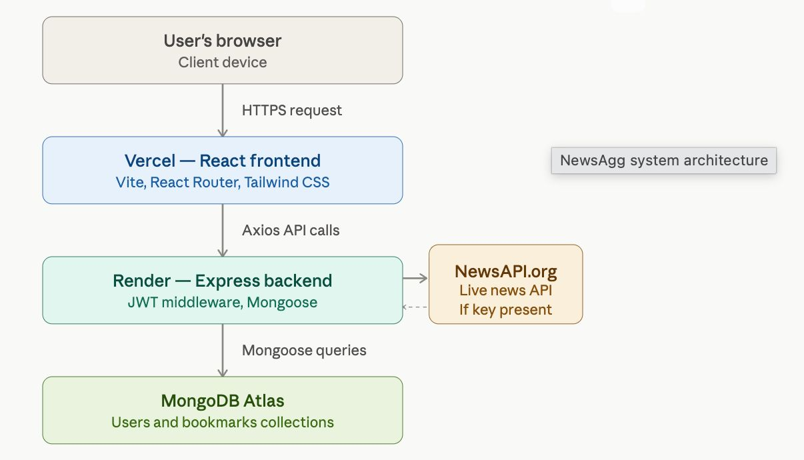
Architecture Diagram
Notes:
Project Scope
Statement: The project statement as provided by the instructor.
Scope Boundaries: What is and isn't covered by the project.

Slide 5
Project Scope
NewsAgg covers the full news-browsing lifecycle: aggregating articles from NewsAPI (with local JSON fallback), category-based filtering, keyword search, user registration/login, personalized category preferences, bookmarking articles, and profile management.
The scope is limited to a single-user personalization model (no social/sharing features) and uses a free-tier NewsAPI key with a local dataset fallback, making it fully functional even without live API access - ideal for offline demos and evaluations.
Notes:
Project Scope
Statement: The project statement as provided by the instructor.
Scope Boundaries: What is and isn't covered by the project.

Slide 6
Individual Contributions
Nayani : Backend Development - Built Express REST API, Mongoose schemas (User, Bookmark), JWT authentication middleware, and news controller with NewsAPI integration + fallback logic
Shreya : Frontend Development - Built React UI with Vite, pages (Home, Login, Register, Profile, Bookmarks, CategoryFeed, SearchFeed), React Router setup, and Tailwind CSS styling
Bhavy : Authentication & Security - Implemented bcrypt password hashing, JWT token generation/verification, protected routes (frontend & backend), and input validation with express-validator
Siddharth : Deployment & DevOps - Configured MongoDB Atlas, deployed backend to Render and frontend to Vercel, managed environment variables and CORS/Helmet security settings
Notes:
Individual Contributions
Member 1: Specific role and tasks performed.
Member 2: Specific role and tasks performed.
Member 3: Specific role and tasks performed.
Member 4: Specific role and tasks performed.
…

Slide 7
Project Architecture
Services: MongoDB Atlas (cloud database), Express.js REST API (11 routes across auth, profile, news, bookmarks), React.js frontend (Vite, 8 routes via React Router), Node.js runtime, NewsAPI.org (external news source), Vercel (frontend hosting), Render (backend hosting)
Interaction: The React frontend (hosted on Vercel) sends HTTPS requests via Axios to the Express backend (hosted on Render). The backend authenticates requests using JWT middleware, queries MongoDB Atlas via Mongoose for users and bookmarks, and fetches live news from NewsAPI.org - falling back to a local JSON dataset if the API key is missing or the request fails.
Notes:
Project Architecture
AWS Services: List of AWS services used.
Interaction: How these services work together.

Slide 8
Key Concepts
Features: Live news aggregation with offline fallback, category filtering, keyword search, personalized category preferences, bookmarking system, JWT-based authentication, protected routes on both frontend and backend, responsive card-based UI
Services: NewsAPI (real-time news), MongoDB Atlas (data persistence), JWT (stateless authentication), bcryptjs (password security), Context API (global auth state management), Axios interceptor (automatic token attachment to requests)
Notes:
Key Concepts
Features: Important AWS features utilized.
Services: Key AWS services employed and their significance.

Slide 9
Challenges and Solutions
Problem 1: Live NewsAPI could fail or be rate-limited during demos/evaluation, risking a broken app. Solved by building a two-tier data strategy in newsController.js - if the API key is missing or the request fails, the app automatically falls back to a local JSON dataset (sample_news.json), guaranteeing 100% functionality offline.
Problem 2: Needed secure, stateless authentication without repeating token-handling logic in every component. Solved by centralizing JWT injection in a single Axios instance (services/api.js) using a request interceptor, combined with a React Context API (AuthContext) for global auth state and a ProtectedRoute component to guard private pages.
Notes:
Challenges and Solutions
Problem 1: Description and resolution.
Problem 2: Description and resolution.

Slide 10
Cost Analysis (Optional)
Cost Breakdown: MongoDB Atlas - M0 Free Tier (Mumbai region), $0. Vercel - Free tier frontend hosting, $0. Render - Free tier backend hosting, $0. NewsAPI - Free developer tier, $0.
Budgeting: All services were kept within free-tier limits, making the project's running cost $0. The local JSON fallback further reduces dependency on paid/rate-limited API calls, keeping the project sustainable for long-term demos with zero infrastructure cost.
Notes:
Cost Analysis
Cost Breakdown: Summary of AWS costs.
Budgeting: How costs were managed or optimized.

Slide 11
Security Measures
Authentication: Passwords are hashed using bcryptjs with 10 salt rounds before storage - never stored in plain text. On login/register, a JWT token (30-day expiry) is issued via generateToken(). Protected API routes use custom authMiddleware to verify the JWT from the Authorization: Bearer header before granting access.
Data Protection: Security headers enforced via helmet middleware on all responses. CORS is restricted to the specific FRONTEND_URL environment variable. All input is validated using express-validator on auth endpoints. Secrets (JWT_SECRET, MongoDB URI, NewsAPI key) are stored in .env files and never committed to Git.
Notes:
Security Measures
Authentication: Steps taken for secure access.
Data Protection: Measures for data security and privacy.

Slide 12
Lessons Learned
Technical Insights: Gained hands-on experience with the full MERN stack - designing Mongoose schemas and relationships, building secure REST APIs, implementing JWT authentication end-to-end, and managing global state in React using Context API instead of Redux for a leaner architecture.
Process Insights: Learned the importance of building resilient systems (API fallback strategy) for real-world reliability, structuring a monorepo for independent frontend/backend deployment, and keeping environment configuration and secrets properly separated between development and production.
Notes:
Lessons Learned
Technical Insights: What was learned technically.
Process Insights: What was learned about team collaboration.

Slide 13
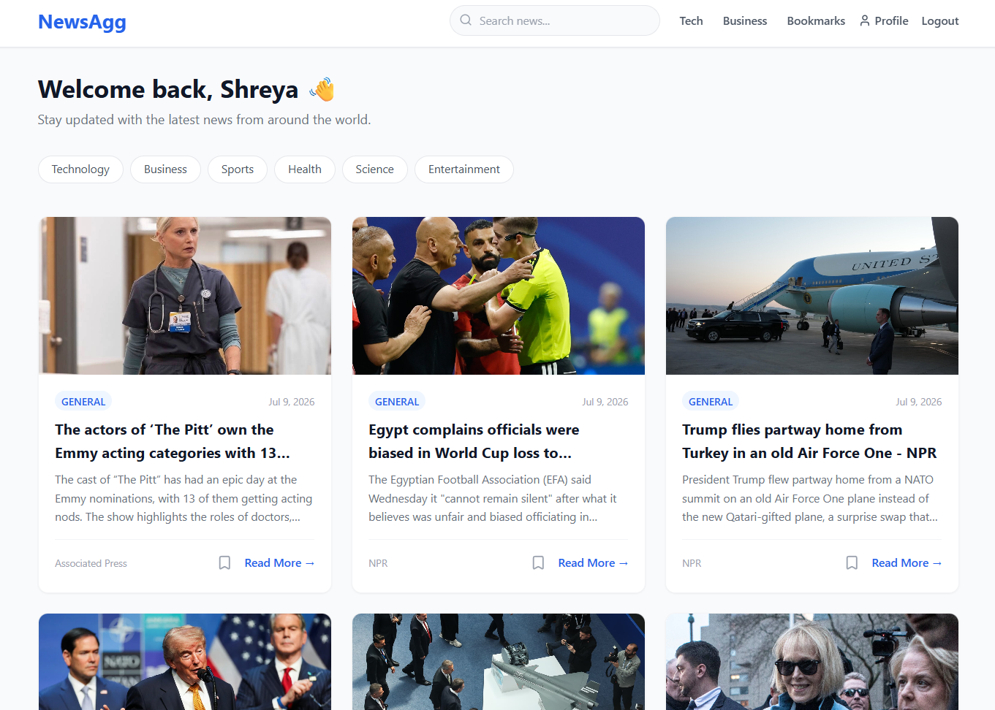
Homepage displaying top headlines in a responsive card grid layout
Notes:
Screenshots
Screen Captures: Visual snapshots to showcase key elements.
Context: Description explaining what the screenshot represents.

Slide 14
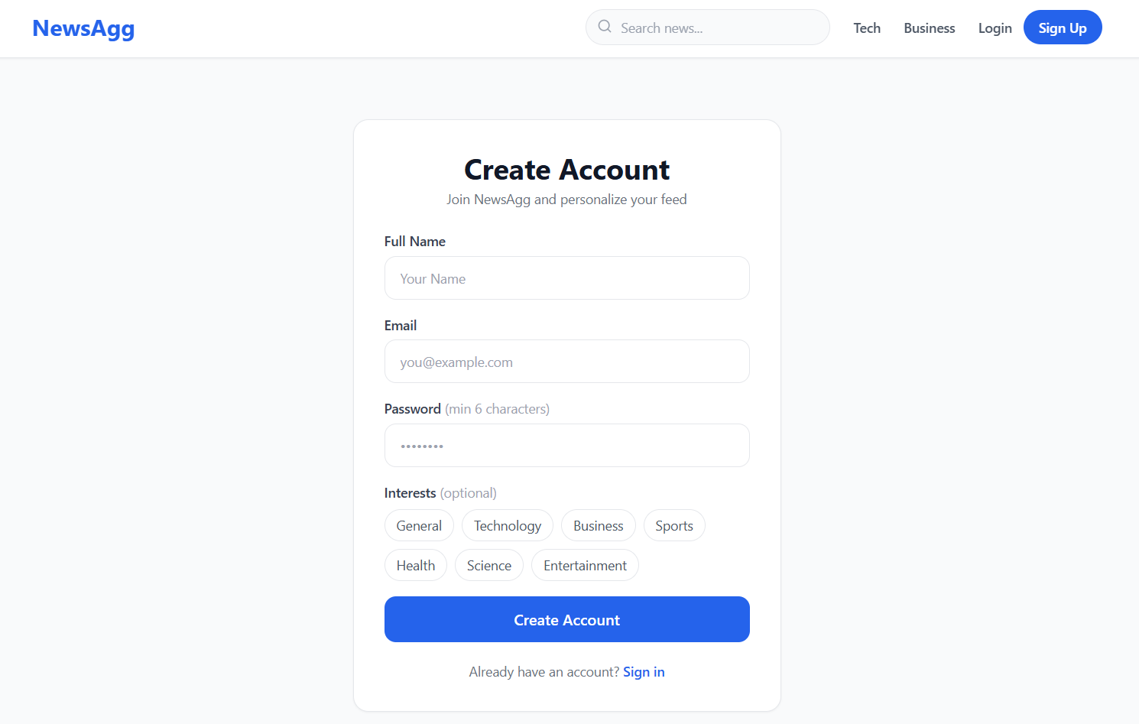
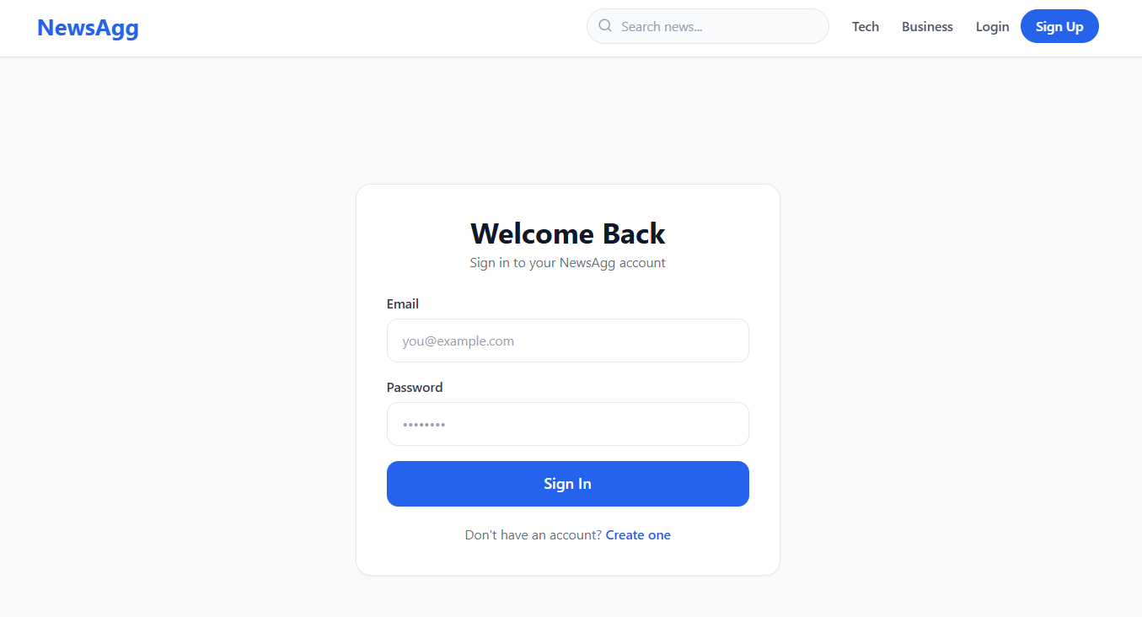
User registration form with category preference selection for feed personalization
Notes:
Screenshots
Screen Captures: Visual snapshots to showcase key elements.
Context: Description explaining what the screenshot represents.

Slide 15
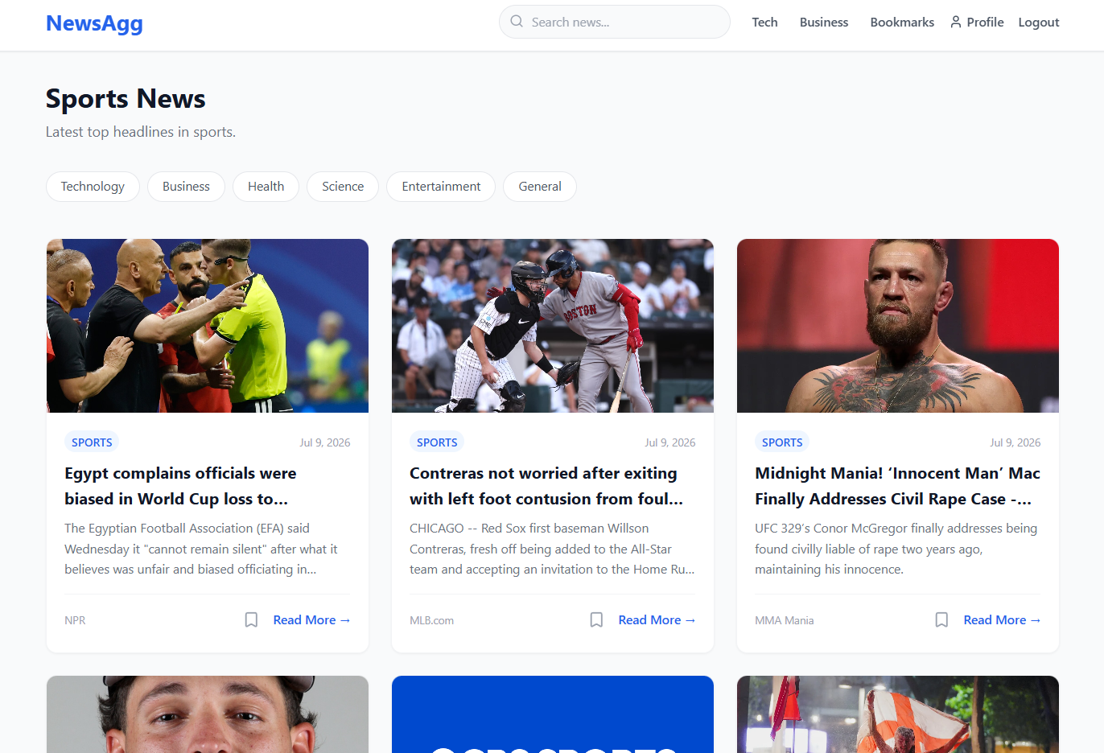
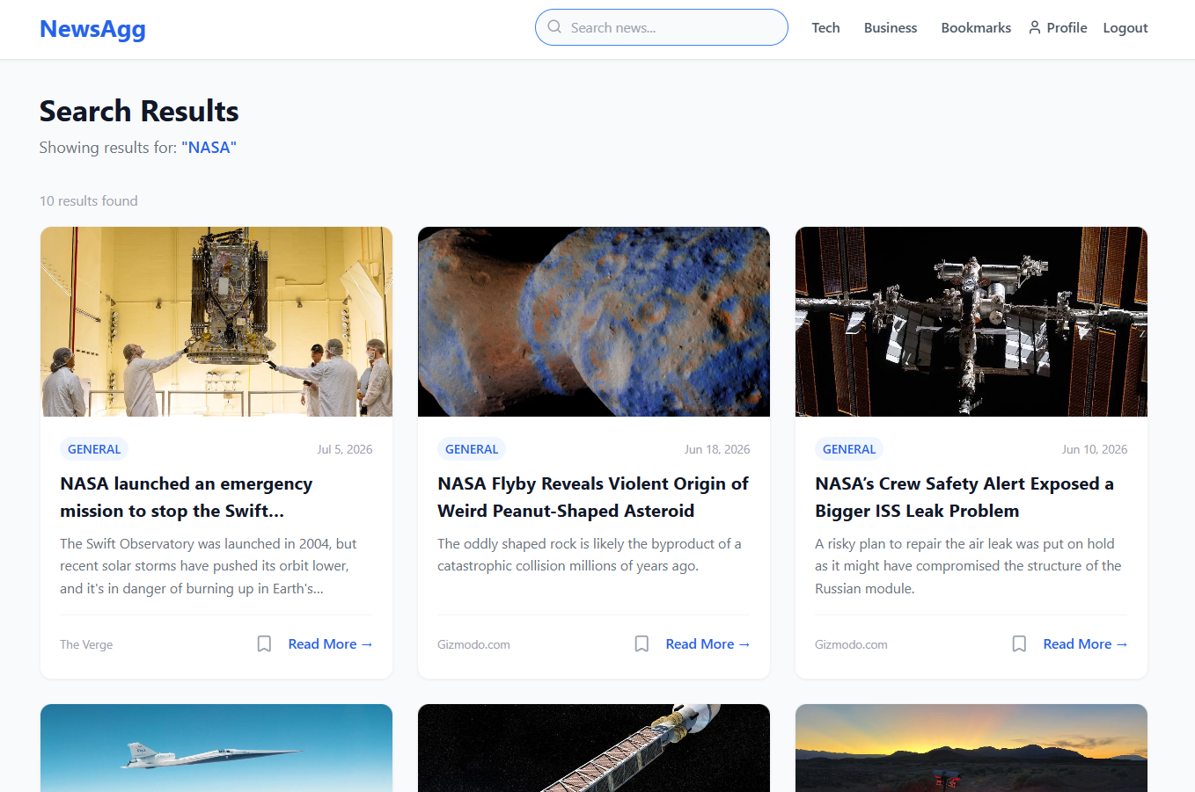
Category-filtered news feed and live search results page
Notes:
Screenshots
Screen Captures: Visual snapshots to showcase key elements.
Context: Description explaining what the screenshot represents.

Slide 16
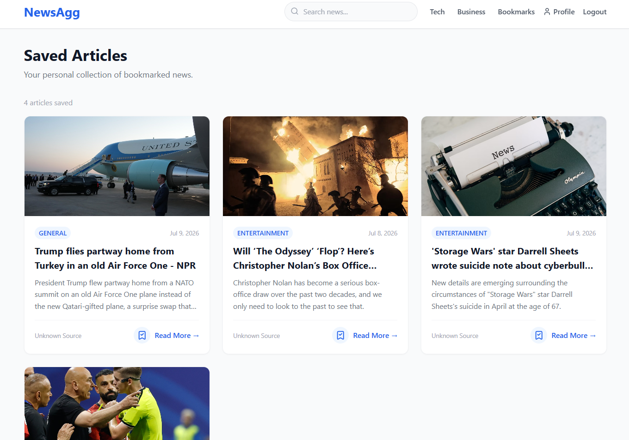
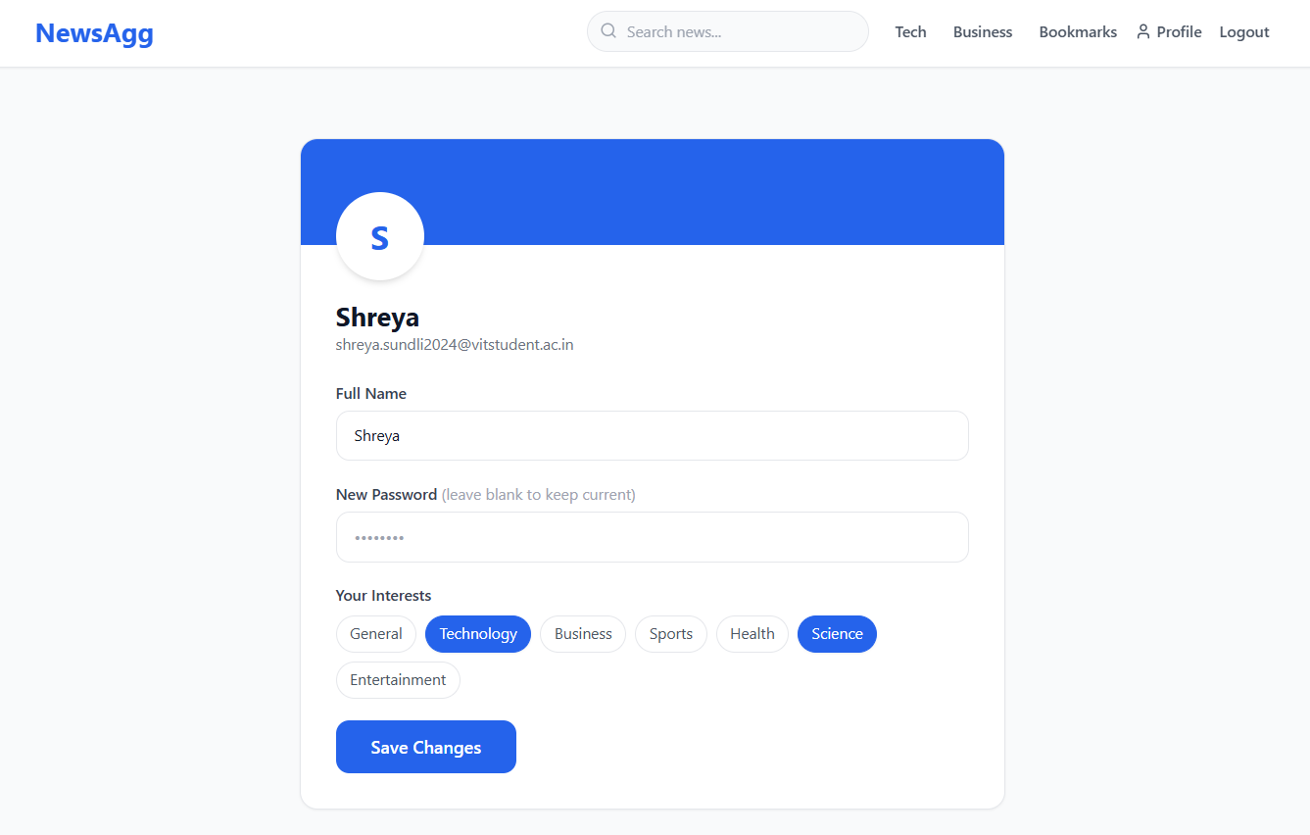
User's saved bookmarks and profile editor showing preferred categories
NEWS AGGREGATOR

Slide 17
Live Demo
Record a live demonstration of your project and upload the video to your Google Drive.
Ensure that the video is shared with public access so that it can be viewed without restrictions.
Add the demo video link to this slide in the designated section.
LIVE DEMO DRIVE LINK : https://drive.google.com/file/d/1Rbwfnp7iHOigTDGeBC5KReGQnfMIXDRg/view?usp=sharing
Notes:
Live Demo
Demonstration: Real-time showcase of the project's functionality and features.
A specific example or scenario illustrating the project in action.

Slide 18
Future Scope
Improvements: Add social features like article sharing and comments, infinite scroll/pagination for news feeds, dark mode UI, email notifications for new articles in preferred categories, and multi-language news support.
Next Steps: Integrate a paid NewsAPI tier or multiple news sources for richer content, add a recommendation engine based on reading/bookmark history, implement Redis caching to reduce API calls, and add automated testing (Jest/Supertest) with CI/CD pipelines.
Notes:
Future Scope
Improvements: Potential updates or add-ons.
Next Steps: Future phases or expansions.

Slide 19
Questions
Questions: Opening the floor for any questions from the audience.
Notes:
Q&A
Questions: Opening the floor for any questions from the audience.

Slide 20
Thank You!
NEWS AGGREGATOR
Group 24
Shreya Sundli
Siddharth Verma
Vakati Narayani Nayani
Bhavy Hrishikesh
Notes:
Thank You
Acknowledgments: Thanks to those who contributed.
Contact Info: How to reach the team for further queries.

